Slide 1
Multithreading III
Lecture 29

Slide 2
Learning objectives
After the completion of today’s session you will be able to:
Analyze the concept of inter thread communication.
Demonstrate the problem of deadlock
Illustrate the concept of Daemon thread

Slide 3
Polling
The process of testing a condition repeatedly till it becomes true is known as polling.
Polling is usually implemented with the help of loops to check whether a particular condition is true or not. If it is true, certain action is taken.
This waste many CPU cycles and makes the implementation inefficient.
For example, in a classic queuing problem where one thread is producing data and other is consuming it

Slide 4
Solution to polling
To avoid polling, Java uses three methods, namely, wait(), notify() and notifyAll().
All these methods belong to object class as final so that all classes have them. They must be used within a synchronized block only.
wait( ) tells the calling thread to give up the monitor and go to sleep until some other thread enters the same monitor and calls notify( ) or notifyAll().
notify( ) wakes up a thread that called wait( ) on the same object.
notifyAll( ) wakes up all the threads that called wait( ) on the same object. One of the threads will be granted access.

Slide 5
Syntax of wait(), notify() and notifyAll()
final void wait( ) throws InterruptedException
final void notify( )
final void notifyAll( )

Slide 6
Inter-Thread Communication
Inter-thread communication or Co-operation is all about allowing synchronized threads to communicate with each other.
Cooperation (Inter-thread communication) is a mechanism in which a thread is paused running in its critical section and another thread is allowed to enter (or lock) in the same critical section to be executed.
It is implemented by following methods of Object class:
wait()
notify()
notifyAll()

Slide 7
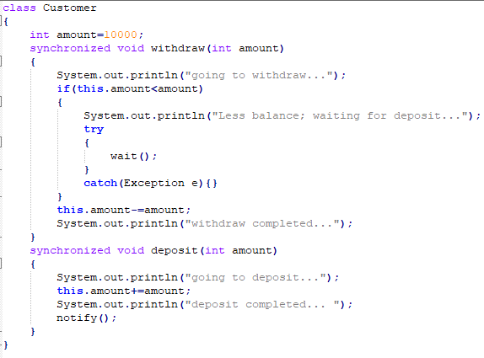
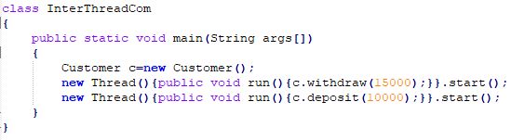

Example
Output

Slide 8
Deadlock
A special type of error that you need to avoid that relates specifically to multitasking is deadlock, which occurs when two threads have a circular dependency on a pair of synchronized objects.
For example, suppose one thread enters the monitor on object X and another thread enters the monitor on object Y.
If the thread in X tries to call any synchronized method on Y, it will block as expected.
However, if the thread in Y, in turn, tries to call any synchronized method on X, the thread waits forever, because to access X, it would have to release its own lock on Y so that the first thread could complete.
Deadlock is a difficult error to debug for two reasons:
In general, it occurs only rarely, when the two threads time-slice in just the right way.
It may involve more than two threads and two synchronized objects

Slide 9
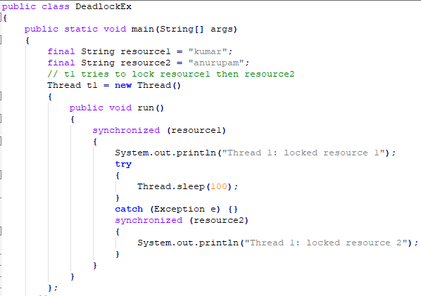
Example

Slide 10
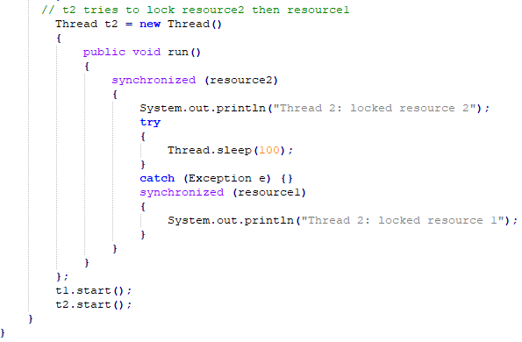

Example
Output

Slide 11
Daemon thread
Daemon thread in java is a service provider thread that provides services to the user thread.
Its life depend on the mercy of user threads i.e. when all the user threads dies, JVM terminates this thread automatically.
It provides services to user threads for background supporting tasks. It has no role in life than to serve user threads.
Its life depends on user threads.
Daemon thread is a low priority thread that runs in background to perform tasks such as garbage collection.

Slide 12
Daemon threads method
public void setDaemon(boolean status): It is used to mark the current thread as daemon thread or user thread.
public boolean isDaemon(): It is used to check that current is daemon.

Slide 13
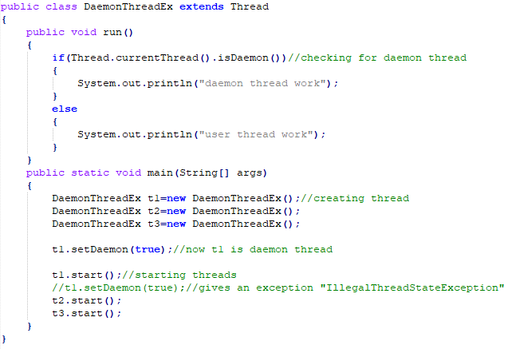
Example

Slide 14
Thanks

